Slide 1


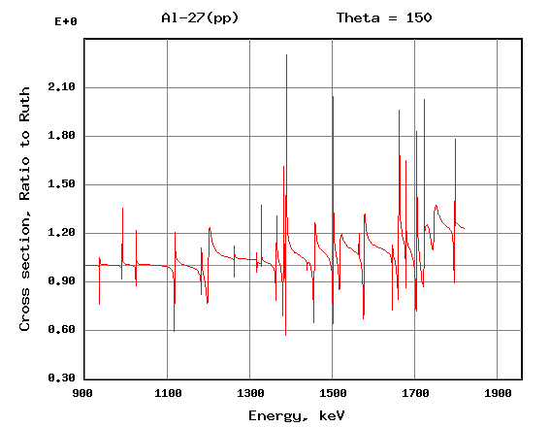
12th International Conference on Transportation Systems Engineering and Management (CTSEM 2026)
Department of Civil Engineering, Mahindra University, Hyderabad
Title of Your Paper
Name of Author (s)
Department Name and/or Institution Name
your-email@email.com
Your Institute Logo
Paper ID:
ABSTRACT
OUTCOME / RESULTS
The poster should be a visual presentation of your paper. Please read the CTSEM-2026 guidelines on the preparation posters first.
Write a summary of your paper in bullet points. The summary should only address key points of your paper.
Print this poster as a single slide, presentation
Authors are responsible for bringing their printed poster to the conference venue. Printing facilities will not be available at the venue.
Text
Text
Text
Layout Recommendations
A three-column layout is recommended. The suggested space allocation is as follows:
• Title – 10%
• Introduction & Objectives – 20%
• Methodology – 20%
• Results – 35%
• Conclusions – 10%
• References – 5%
Font Sizes
Use clear fonts such as: Arial, Calibri, or Times New Roman. Recommended minimum font sizes are as follows:
Title 72–96 pt
Author Names 40–48 pt
Section Headings 32–40 pt
Body Text 24–30 pt
Figure Captions ≥20 pt
BACKGROUND / INTRODUCTION
This section should be used to explain the background of or introduce your paper. Make sure to identify objectives of your topic.
You may adjust size of these text boxes as needed.
Poster Content
The poster should clearly communicate the research and should preferably contain the following sections:
• Title
• Authors and Affiliations
• Introduction / Background
• Research Objectives
• Methodology
• Study Area (if applicable)
• Results
• Discussion
• Conclusions
• Key References
• Acknowledgements (optional)
Table: Study Results
Column 1 | Column 2 | Column 3 | Column 4
CONCLUSION
CHALLENGES / METHODS / IMPLEMENTATION
Be sure that your results are clear and self-explanatory.
Please ensure any logos, graphics or images inserted are of a high resolution to avoid them pixelating.
Conclusions should be bullet points.
Figures and Tables
Use high-resolution figures.
Label all axes clearly.
Include units wherever applicable.
Avoid overcrowding.
General Design Tips
Keep text concise.
Prefer bullet points over paragraphs.
Use adequate white space.
Maintain good contrast.
Avoid decorative backgrounds.
Use colour consistently.
This section can be adjusted to address “challenges”, “methods”, “implementation” or others depending on the content of your paper, should demonstrate clear view/vision of your topic.
Using graphs/figures are recommended to provide information visually. Author(s) is responsible for ensuring that nothing in his/her paper infringes any existing copyright. Make sure to label the graph/figures clearly and indicate source, as necessary.
The message that your poster contains should be clear and understandable without the requirement of oral explanation. If relevant, methods should be presented simply and concisely.
ACKNOWLEDGEMENTS / REFERENCES
During Poster Session
Authors should:
Mount the poster before the session begins.
Remain near their poster during the assigned session.
Be prepared to provide a 3–5 minute overview.
Engage with participants and answer questions.
Fig: Methodology

